Slide 1
Brightness and volume control using hand gesture
Raja Kumari S (21BAD020)
Bhuvanika S (21BAD006)
Suji S (21BAD026)

Slide 2
Introduction
INTRODUCTION
Volume and Brightness Control Using Hand Gestures leverages computer vision to create a hands-free method for adjusting system settings.
Using MediaPipe and OpenCV in Python, it captures real-time video to detect hand landmarks and interprets specific gestures for controlling brightness and volume.
The distance between the thumb and index finger of the left hand adjusts the screen brightness, while the right hand increases or decreases the volume.
This intuitive approach demonstrates the effectiveness of gesture-based control in enhancing user interaction with devices.

Slide 3
APPROACH
A webcam captures live video for hand gesture detection.
MediaPipe is used to detect key hand landmarks.
OpenCV processes video frames, converting them to grayscale for better gesture detection.
The distance between the thumb and index finger is measured to interpret gestures.
The left hand's thumb-index finger distance adjusts the screen brightness.
The right hand's thumb-index finger positioning controls the volume (up or down).
pyautogui and screen_brightness_control libraries adjust system volume and brightness.

Slide 4
Objective
Enhance user convenience by eliminating the need for physical touch or traditional controls.
Ensure seamless interaction by utilizing computer vision techniques to accurately detect and interpret hand gestures in real-time.
Create a responsive system that delivers real-time feedback and smooth control of brightness and volume based on user gestures.

Slide 5
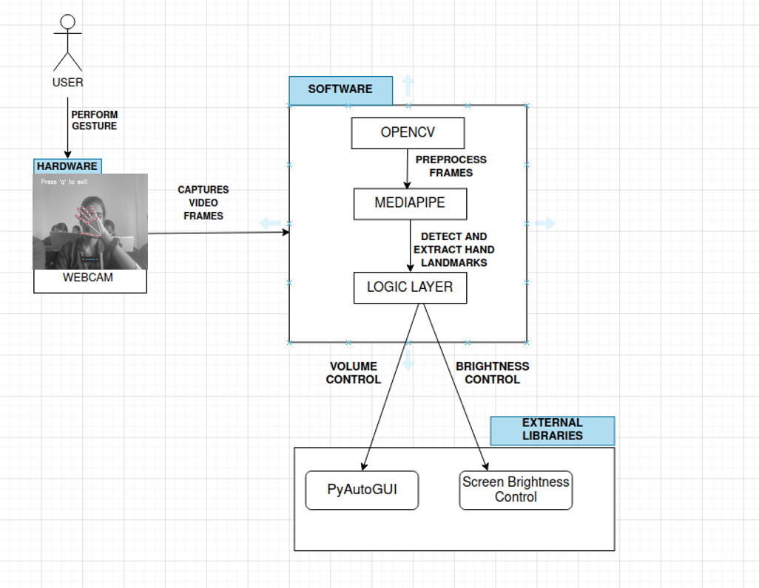
SYSTEM DESIGN

Slide 6
Technology Stack
Hardware Component
Webcam
Software Component
Python
Libraries Used
Open-cv python
Mediapipe
Numpy
Pyautogui
Screen-brightness-control

Slide 7
Hand Gestures
Left Hand
Brightness Control
Distance between the thumb tip and index finger tip controls the brightness.
The closer the thumb and index finger, the lower the brightness. The further apart, the higher the brightness.
Right Hand
Volume Control
If the thumb tip is above the index finger tip, the volume will increase.
If the thumb tip is below the index finger tip, the volume will decrease

Slide 8
System Design
Captures Video Frames
Detects hand Gestures
Camera / device
Gesture Detection
(MediaPipe / OpenCV)
Gesture Regonition
Recognizes Gesture
Provides Feedback
Control Interface
(Brightness and Volume)
User Feedback
Adjusts Brightness/ Volume

Slide 9
Implementation
from math import hypot
import cv2
import mediapipe as mp
import numpy as np
import pyautogui
import screen_brightness_control as abc
# Initialize MediaPipe hands
mp_hands = mp.solutions.hands
hands = mp_hands.Hands(static_image_mode=False, max_num_hands=2,
min_detection_confidence=0.5, min_tracking_confidence=0.5)
mp_drawing = mp.solutions.drawing_utils #draw landmarks on the detected hands
# Initialize webcam
cap = cv2.VideoCapture(0) #0 refers to the default camera
# Create a named window and set it to full screen
cv2.namedWindow('Hand Gesture', cv2.WND_PROP_FULLSCREEN)
cv2.setWindowProperty('Hand Gesture', cv2.WND_PROP_FULLSCREEN, cv2.WINDOW_FULLSCREEN)

Slide 10
Implementation
while True:
ret, frame = cap.read() #ret is a boolean indicating success (True if the frame was successfully read), and frame is the captured image.
if not ret:
break#If the frame is not captured successfully (ret is False
# Convert the frame to grayscale for the black-and-white filter
frame_gray = cv2.cvtColor(frame, cv2.COLOR_BGR2GRAY)
# Convert grayscale back to BGR (since MediaPipe expects a 3-channel image)
frame_gray_bgr = cv2.cvtColor(frame_gray, cv2.COLOR_GRAY2BGR)
# Process the frame with MediaPipe hands
results = hands.process(cv2.cvtColor(frame_gray_bgr, cv2.COLOR_BGR2RGB))
# List to store landmarks
lmList = [] #Initializes an empty list to store hand landmarks (x, y positions of key points)
if results.multi_hand_landmarks:#Checks if any hand landmarks are detected.
for hand_landmarks in results.multi_hand_landmarks:#Loops through each detected hand's landmarks.
for id, lm in enumerate(hand_landmarks.landmark):# Loops through each landmark in the hand, getting its id and its normalized coordinates (lm).
h, w, _ = frame.shape#normalized coordinates
cx, cy = int(lm.x * w), int(lm.y * h)#Converts the normalized coordinates to pixel coordinates (cx, cy)
lmList.append([id, cx, cy])#Stores each landmark’s id and its pixel coordinates (cx, cy) in the lmList.
mp_drawing.draw_landmarks(frame_gray_bgr, hand_landmarks, mp_hands.HAND_CONNECTIONS)

Slide 11
Implementation
# Calculate distance between thumb tip and index finger tip
if len(lmList) >= 9:#Ensures that at least 9 landmarks are detected.
x1, y1 = lmList[4][1], lmList[4][2]#Gets the coordinates of the thumb tip (landmark 4).
x2, y2 = lmList[8][1], lmList[8][2]#Gets the coordinates of the index finger tip (landmark 8).
length = hypot(x2 - x1, y2 - y1)#Calculates the Euclidean distance between the thumb tip and index finger tip using the hypot function.
# Adjust brightness based on distance
if lmList[0][1] < w/2: # left hand --->checks if the hand is on the left side of the screen (i.e., controlling brightness).
brightness = np.interp(length, [15, 220], [0, 100])#Maps the distance between the thumb and index finger to a brightness range
abc.set_brightness(int(brightness))
# Detect hand gesture
if lmList[0][1] > w/2: # right hand --->Checks if the hand is on the right side of the screen (i.e., controlling volume).
if lmList[4][2] > lmList[8][2]:
pyautogui.press('volumeup')
else:
pyautogui.press('volumedown')

Slide 12
Implementation
# Add the 'Press q to exit' text on the frame
cv2.putText(frame_gray_bgr, "Press 'q' to exit", (50, 50), cv2.FONT_HERSHEY_SIMPLEX,
1, (255, 255, 255), 2, cv2.LINE_AA)
# Display the frame with grayscale filter and the exit message
cv2.imshow('Hand Gesture', frame_gray_bgr)
# Break the loop if 'q' is pressed
if cv2.waitKey(10) & 0xFF == ord('q'):
break
# Release the webcam and close all windows
cap.release()
cv2.destroyAllWindows()

Slide 13
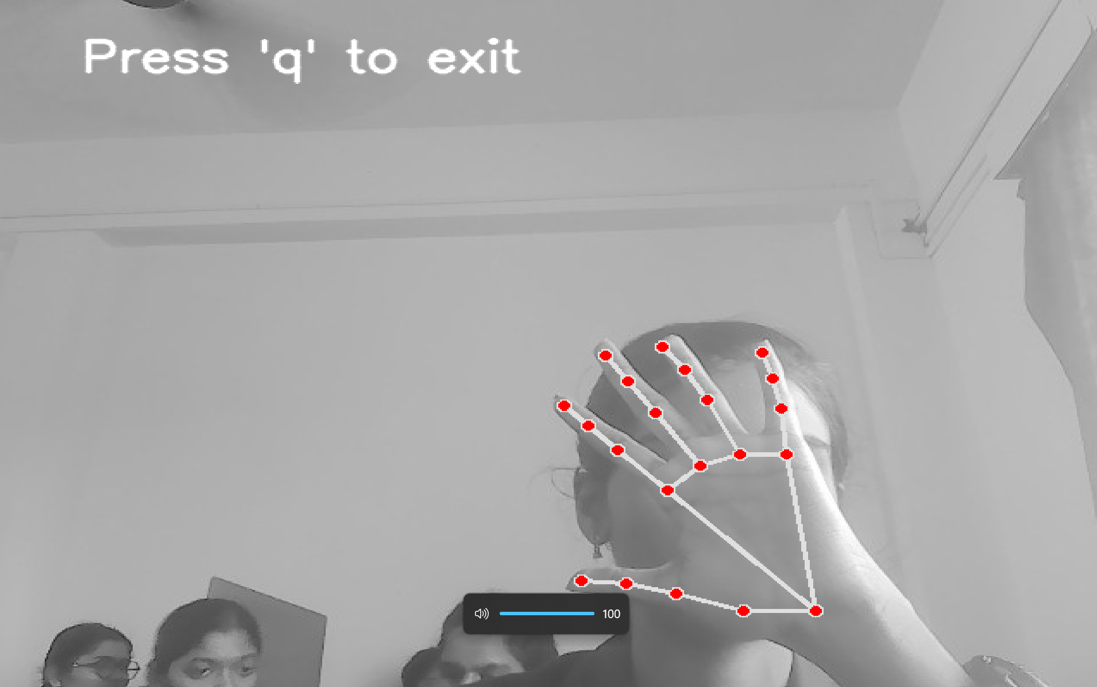
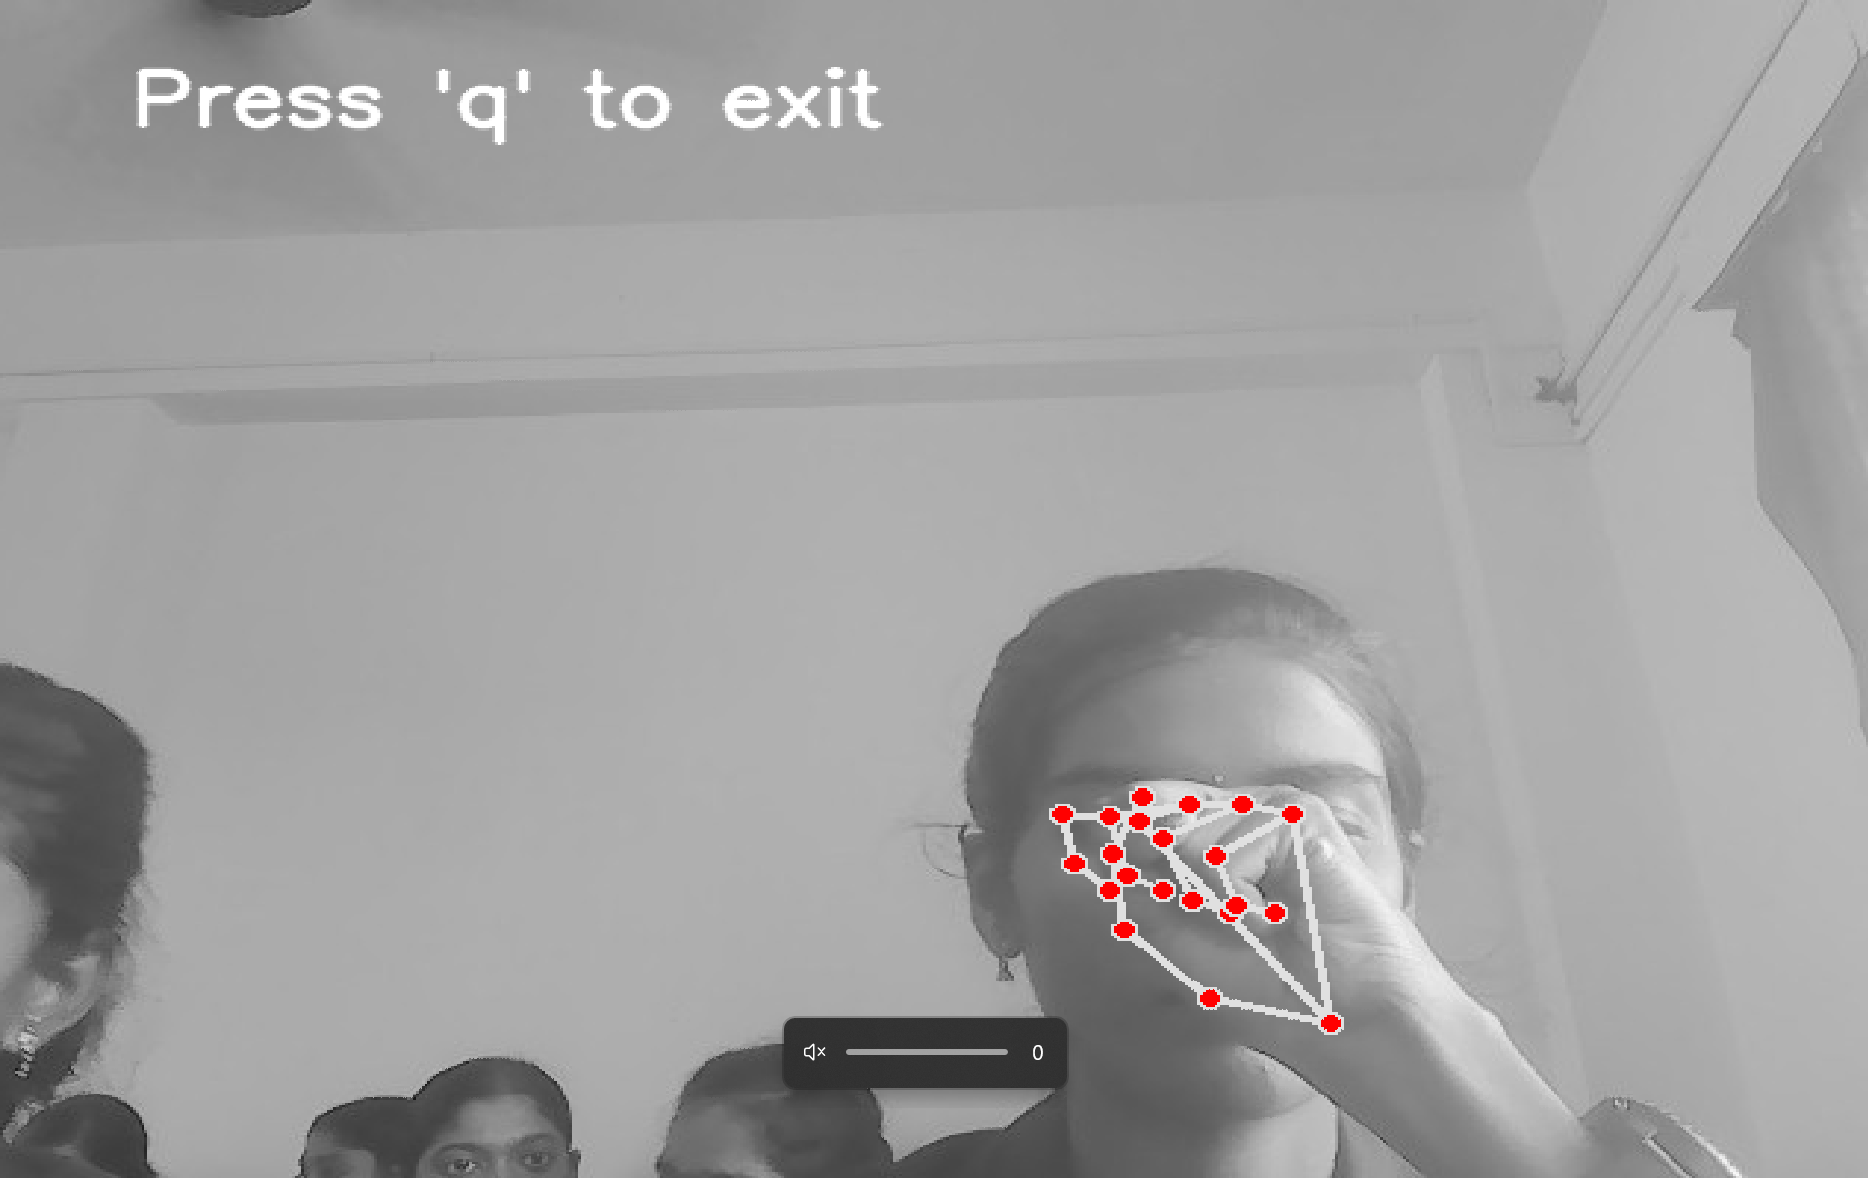
RESULT
VOLUME
CONTROL
RESULT

Slide 14
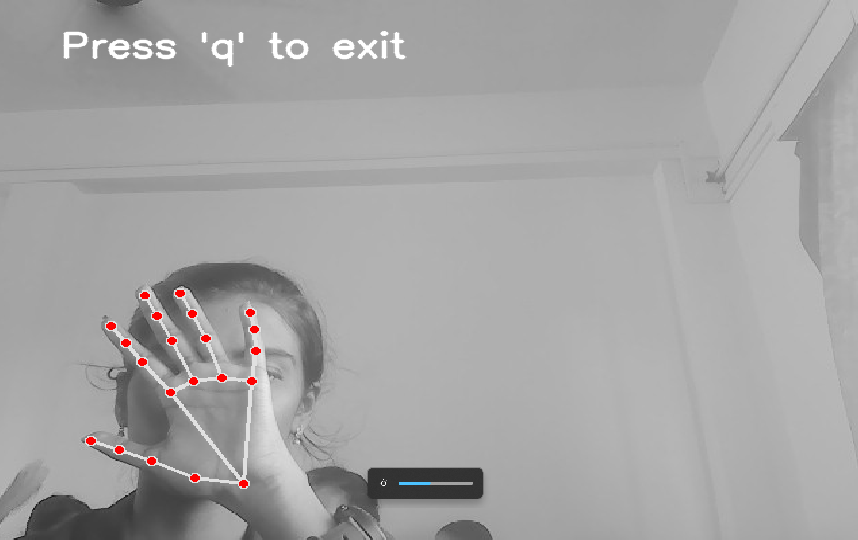
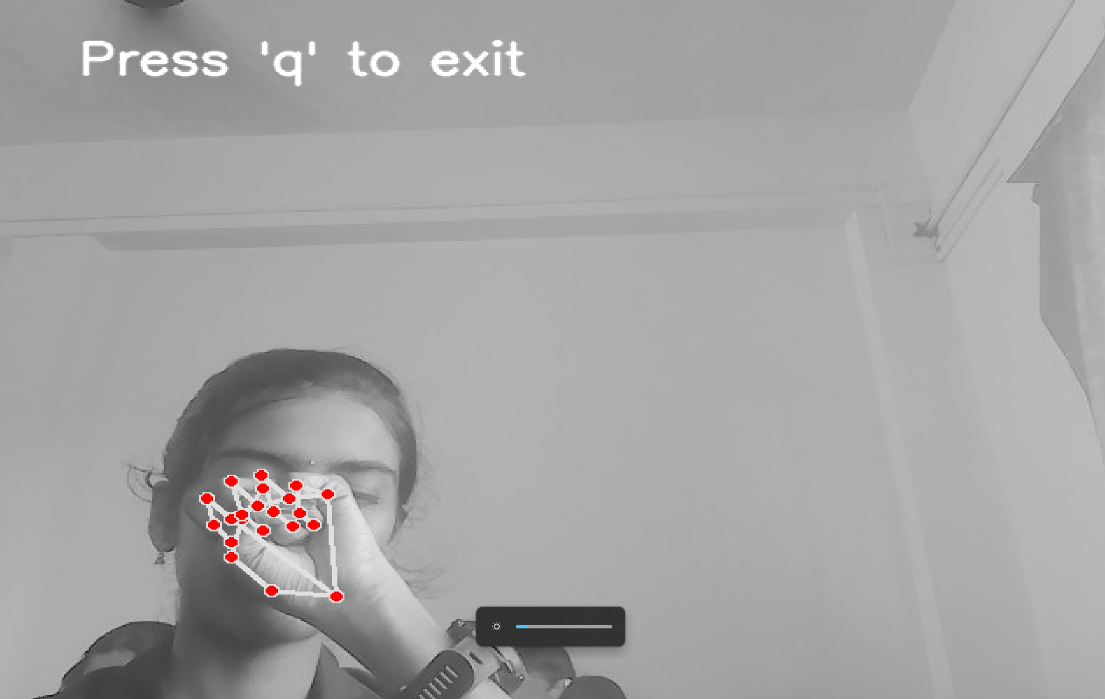
BRIGHTNESS CONTROL
RESULT

Slide 15
Conclusion
Thus the Brightness and Volume Control Using Hand Gestures project demonstrates the potential of gesture-based interfaces in creating more intuitive and seamless ways to interact with technology.
By leveraging computer vision techniques, such as hand detection and gesture recognition using tools like OpenCV and MediaPipe, the system successfully maps hand movements to specific actions for adjusting screen brightness and audio volume.
This touch-free interface offers significant advantages in situations where traditional input devices like keyboards or remote controls are impractical or inconvenient.

